Slide 1
Introduction to Conda, Environments, and Notebooks
Andrew Saydjari, 2022/06/22

Slide 2
Collab Demo Notebook

Slide 3
What is an IDE?
IDE == “Integrated Development Environment”
Graphical user interface that provides developer tools, generally for many languages, with “nice” features:
Plotting
Github integration
Text-editing/syntax coloring
Breakpoints/debugging tools
Running on remote machines
Simultaneous editing with collaborators
Advice: Start with something FUNCTIONAL, and test bells & whistles 1-by-1

Slide 4
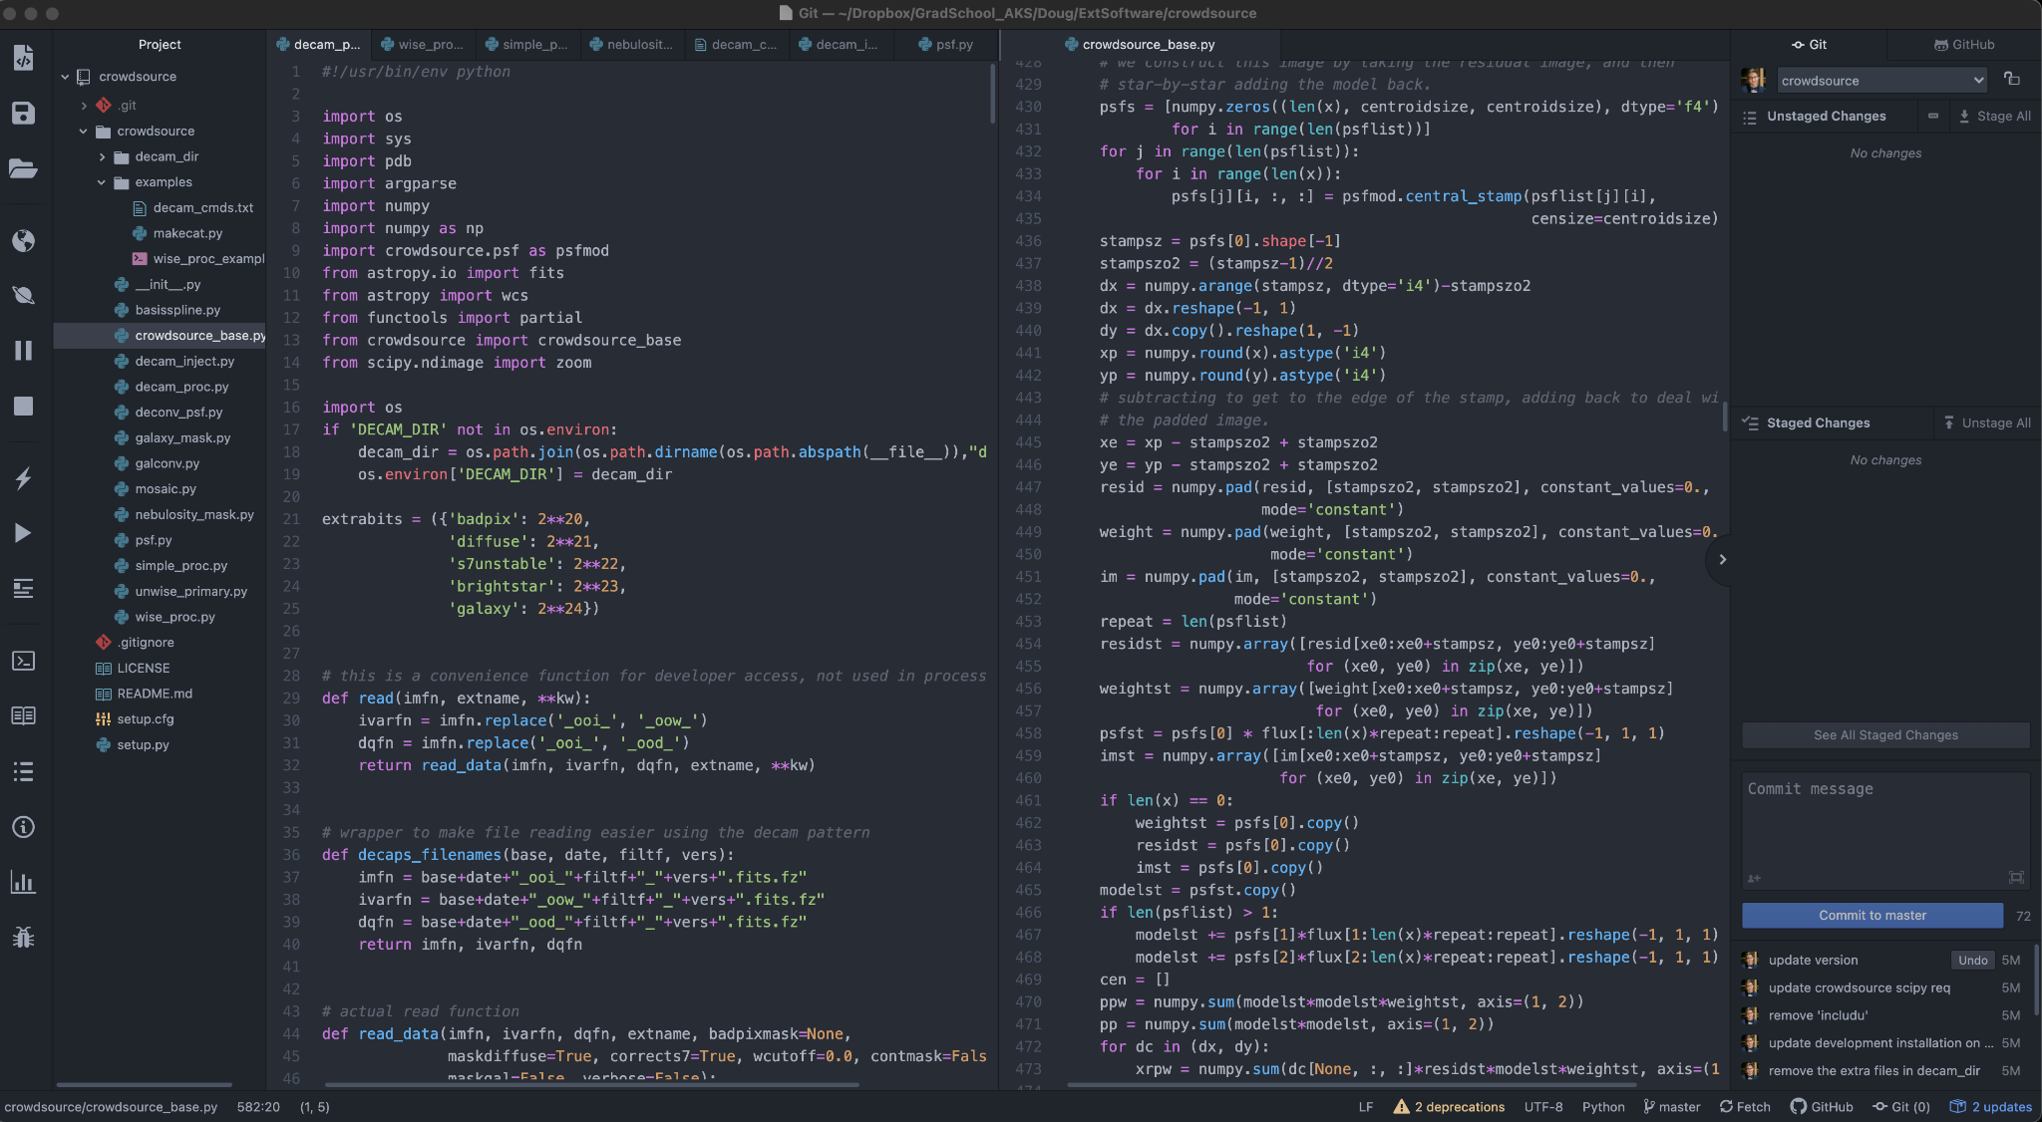
Example: Atom

Slide 5
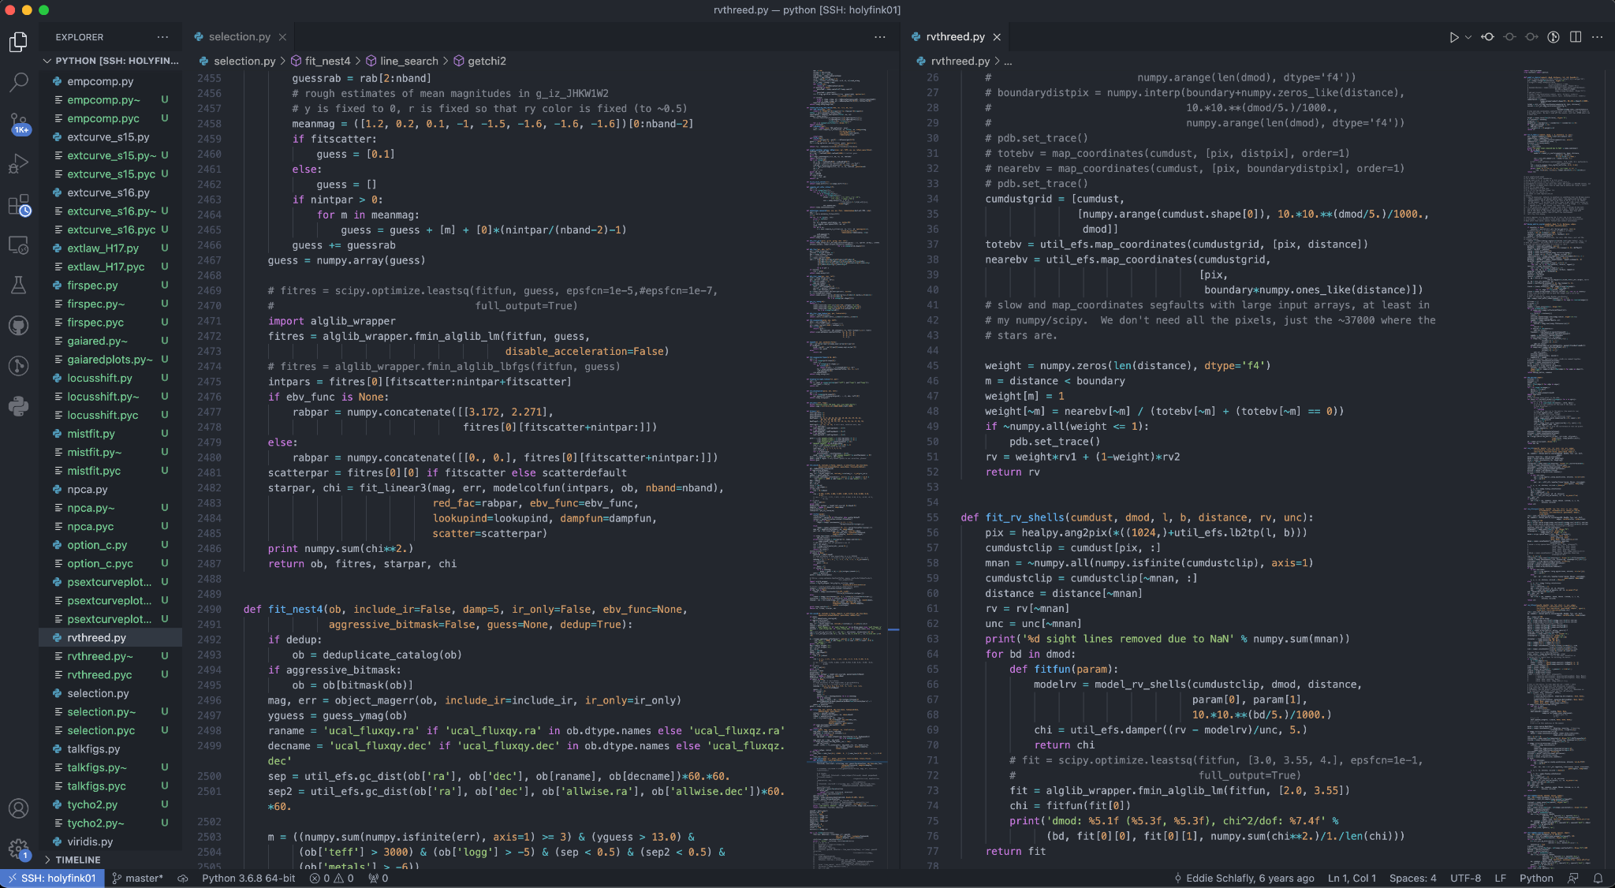
Example: VSCode

Slide 6
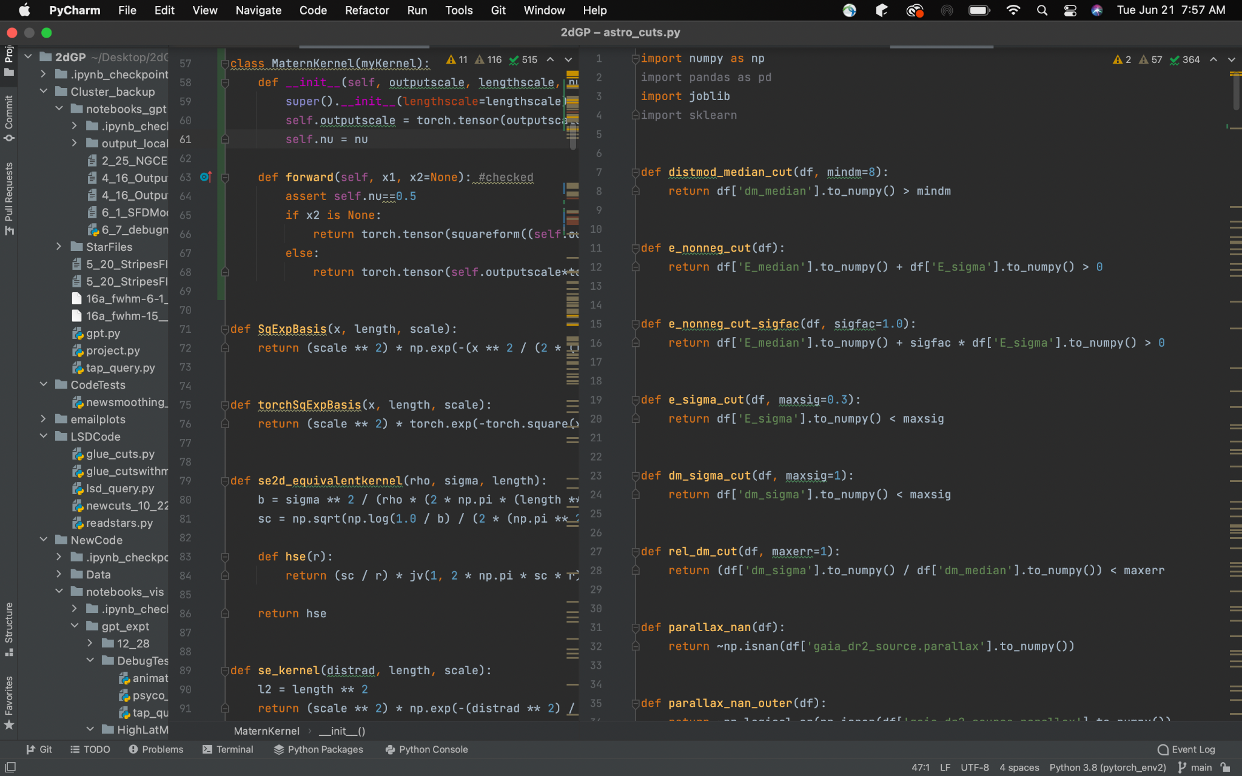
Example: PyCharm (Community)

Slide 7
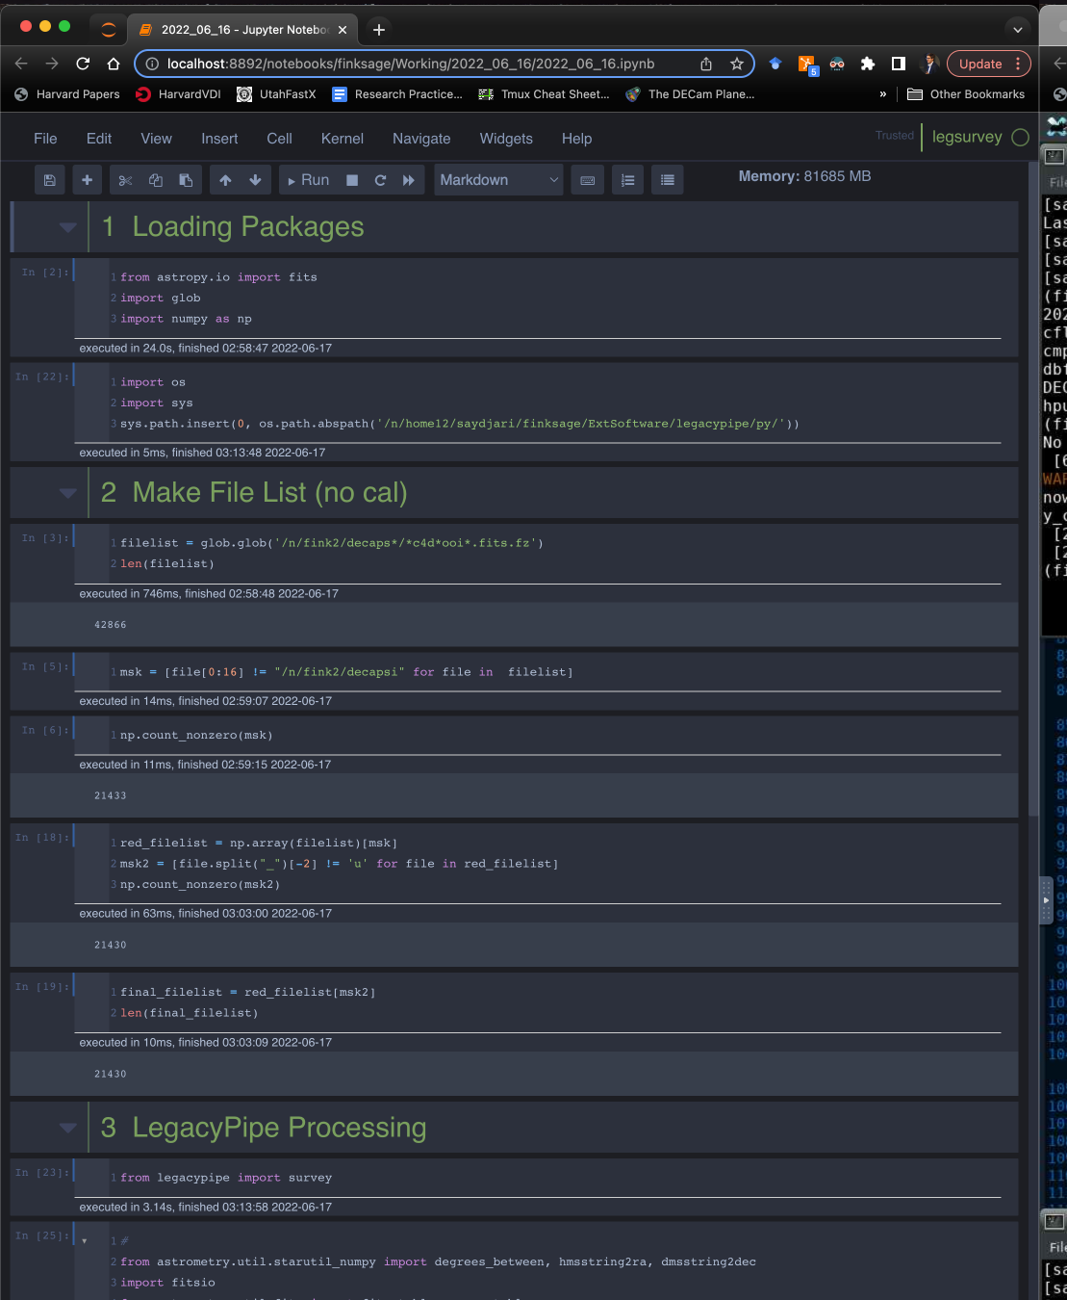
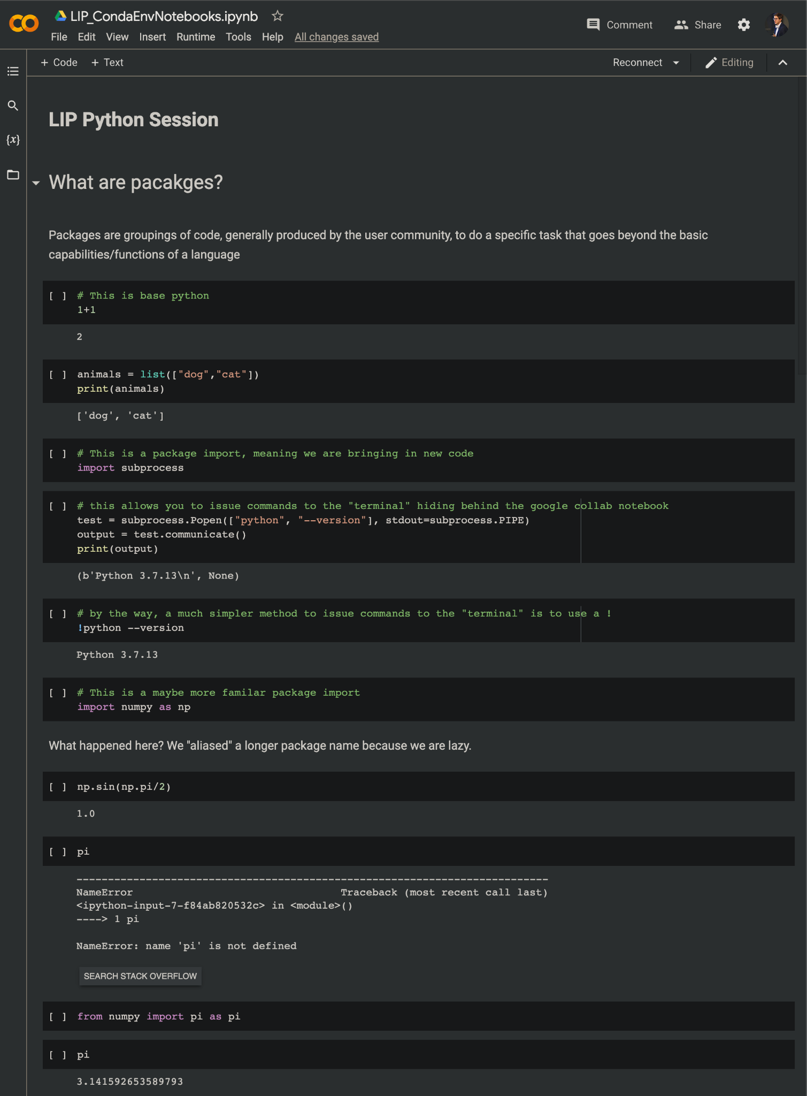
Example: Jupyter

Slide 8
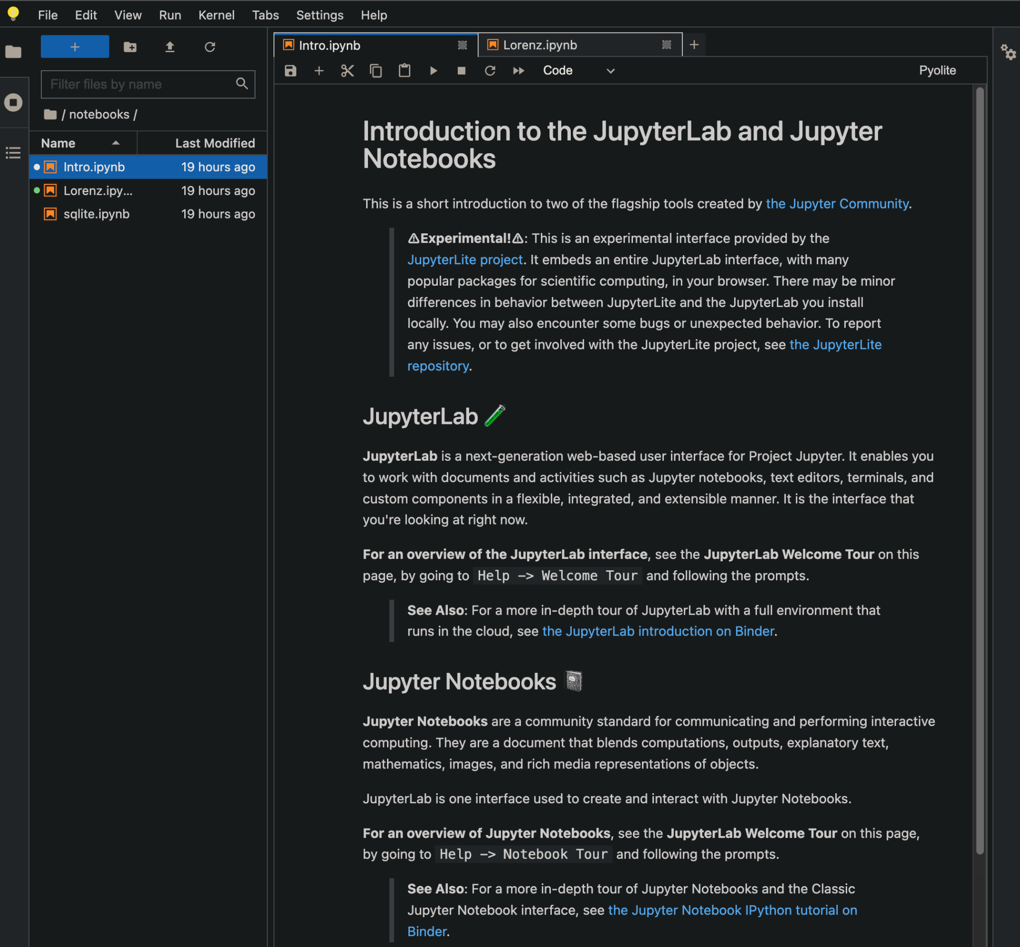
Different Flavors of Jupyter
Location:
Local host (on your laptop)
Graphical Interface on a Cluster (Harvard VDI)
Google Collab (remote host you don’t really see)
Form:
Jupyter Notebook (single flow)
Jupyter Lab (access many notebooks + files)
We will do local host + notebook

Slide 9
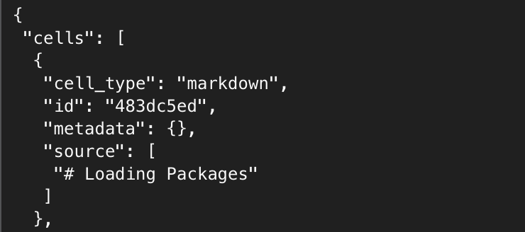
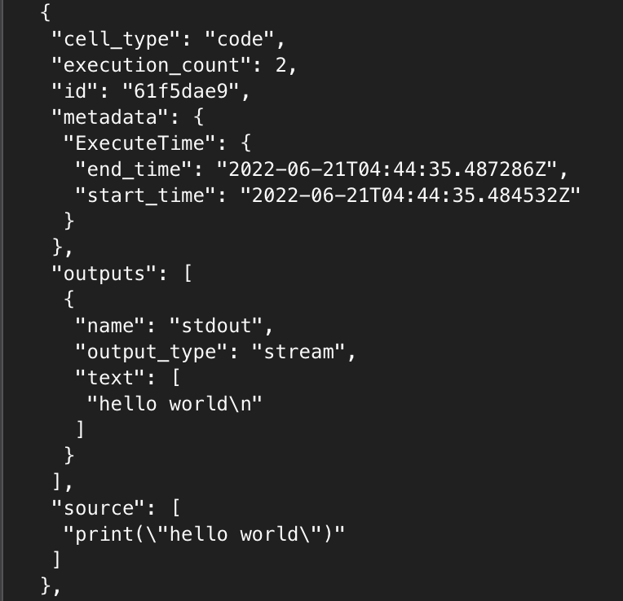
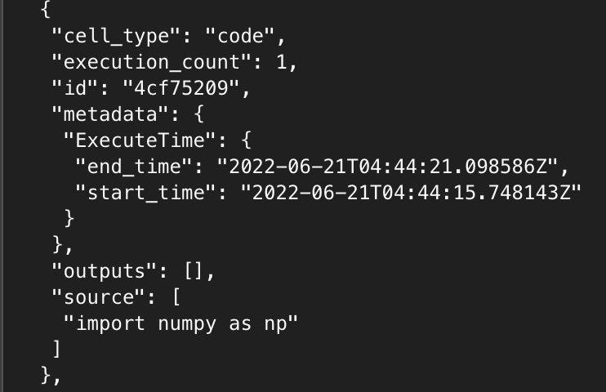
What is a Jupyter Notebook really?
JSON (JavaScript Object Notation)- both human and machine readable (can open with a text editor!)

Slide 10
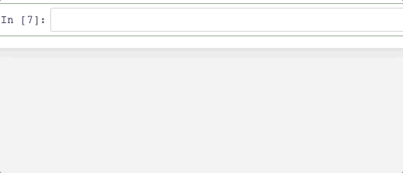
Advanced Jupyter Features
Code-folding
Table of Contents
Colors/Themes
Autocompletion
Cell Timings
Much much more…
Many of these features are being integrated into JupyterLab and other IDEs… Find the set-up that works for you!

Slide 11
To Local Demo Notebook
Go to Canvas Site!

